Slide 1
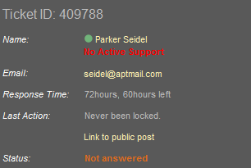
Homework
Create the following page section using HTML and external CSS (no inline styles). Use a table or a definition list (in this case the layout will be different).

Slide 2
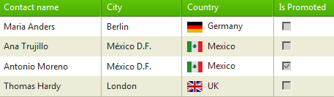
Homework (2)
Create the following Web page using external CSS styles.
Create a web page using the homework-3.png design and the HTML markup in homework-3.html.

Slide 3
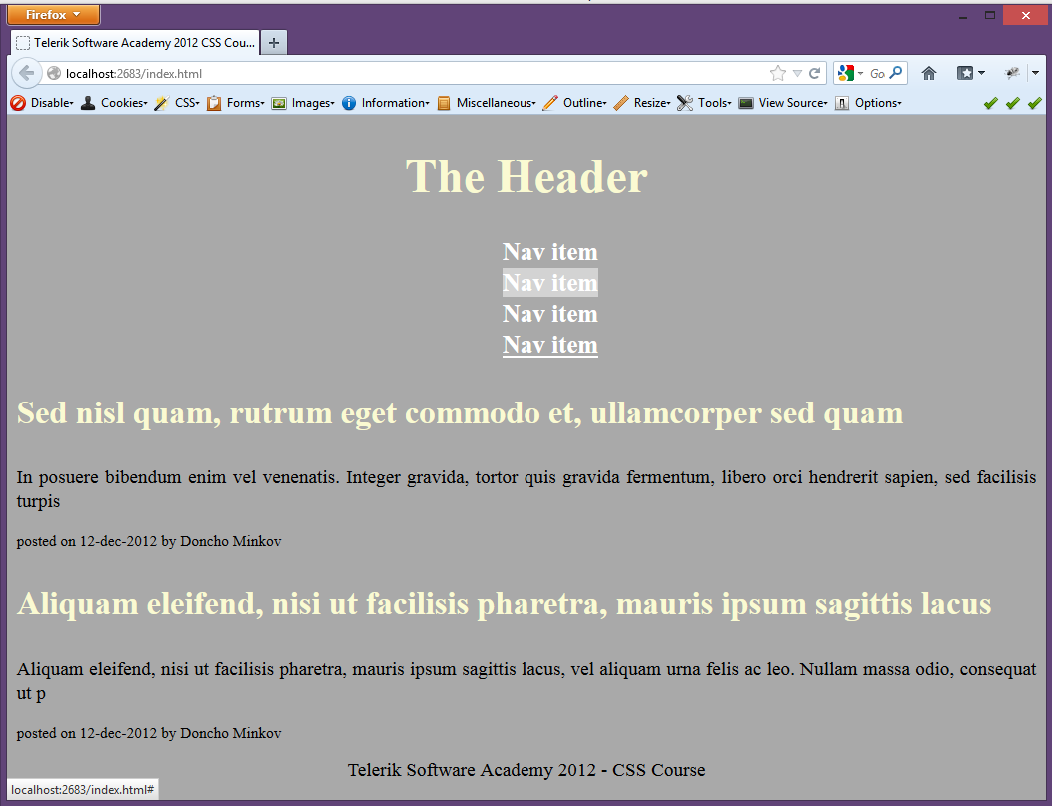
Homework (2)

